Slide 1
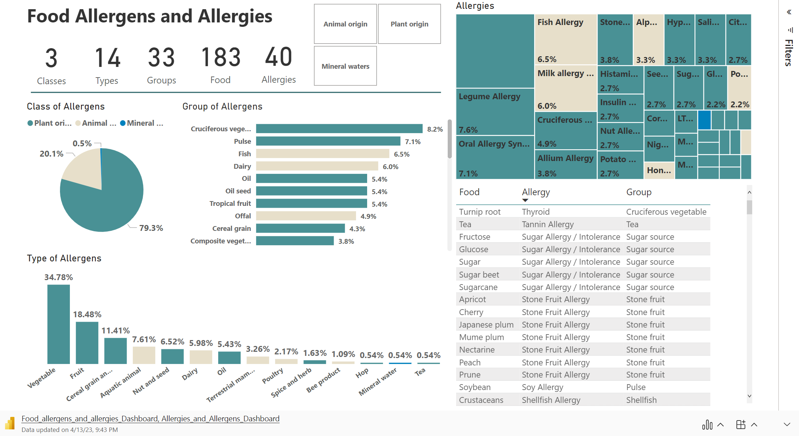
Insert
My Add-ins

